Slide 1
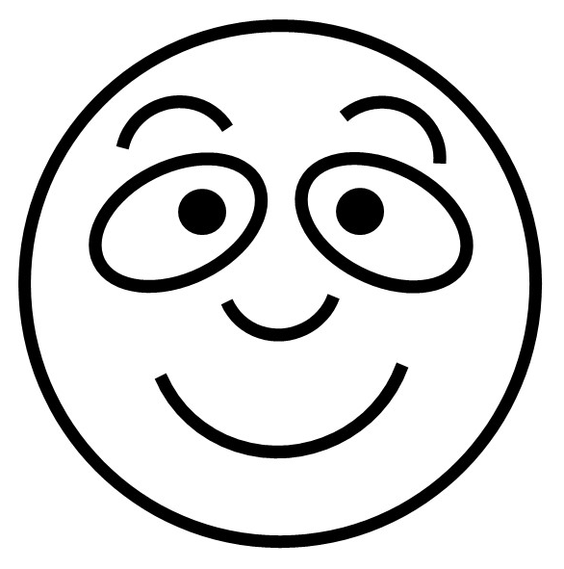

Slide 2
I’m happy
I’m sad
I’m surprised
I’m sick /
I’m not very well
I’m angry
I’m afraid/
I’m scared

