Slide 1
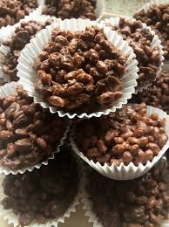
Chocolate Crispies

Slide 2
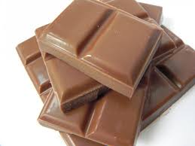
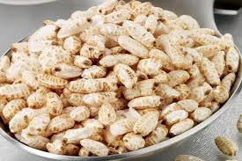
Ingredients
250 grammes of milk chocolate.
100 grammes of puffed rice.

Slide 3
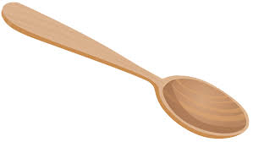
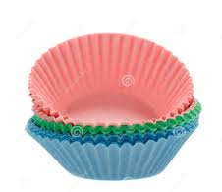
Materials
Saucepan Spoon
Bowl Paper cases

Slide 4
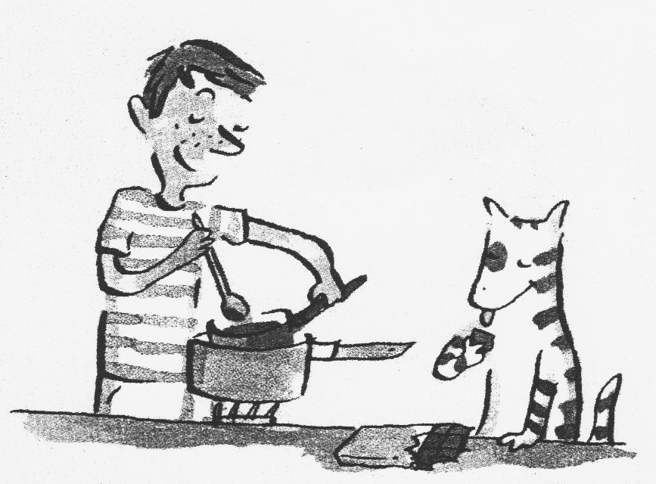
Step 1
Melt the chocolate into a saucepan. Stir.

Slide 5
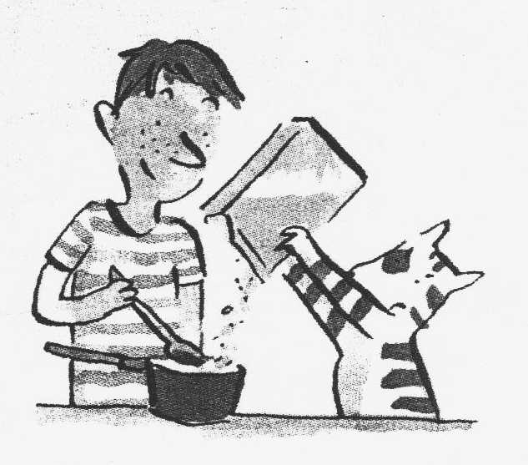
Step 2
Add the puffed rice to the melted chocolate. Stir.

Slide 6
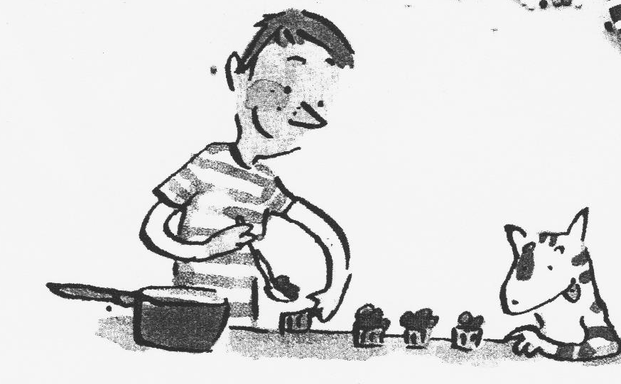
Step 3
Spoon the mixture into the paper cases.

Slide 7
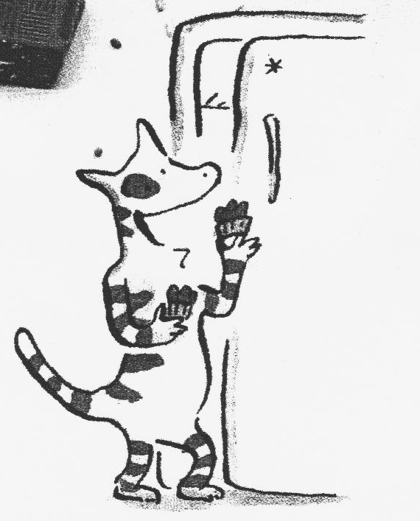
Step 4
Let cool for 1 hour.

Slide 8
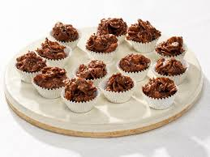
Step 5
Eat and enjoy!

Slide 9
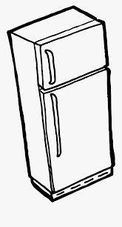
Review the steps!
1. Melt: 4.Spoon:
2. Stir: 5. Let cool:
3. Add: 6. Eat:

